Slide 1

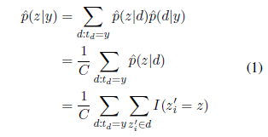

Canonicalize
Collapsed Gibbs Sampling
Post-hoc grouping
Date (Oct/Apr)
Gender
Date X Gender
Visualize Topic Entropy/t
Compute JS Divergence for Pairs
Visualize Topic Entropy/t
Overall Question: Can LDA and post-hoc analysis provide us with greater appreciation for the information in LDS General Conference?
Supporting Questions:
Which topics are popular in recent time?
Does time of year significantly affect the divergence of the venue pairing?
Does gender significantly affect the divergence of the venue pairing?
Do time + gender together affect the divergence?

Slide 2
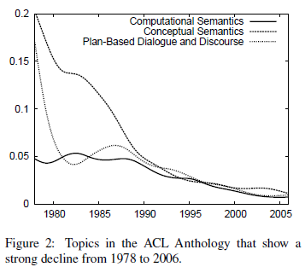
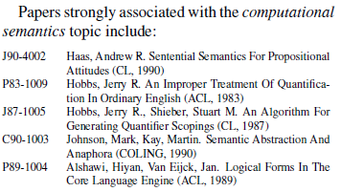
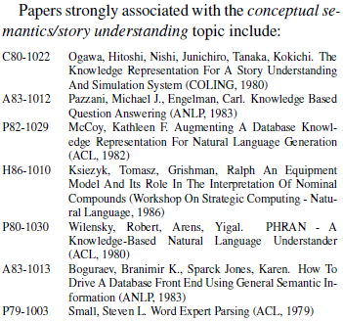
Results
p. 365

Slide 3
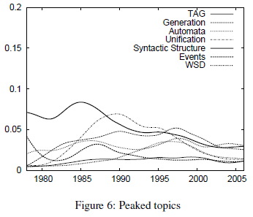
Results: Topic Over Time
p. 368

